Slide 1

Presented By:
Sumit Kumar
Priyanshu Senger
Subham Sharma
Presented To:
Ms. Ruchi Gupta
(Master Trainer)
GLA University,
Mathura

Slide 2

News Aggregator
(News Website)
Git-hub link :https://github.com/PriyanshuSengar/mini-project-II-Session-2024-25

Slide 3
Topics to be covered
Project Overview
Problem Statement
Challenges
Technologies Used
Project Features

Slide 4
Project Overview:
The News Aggregator is a web application built with React.js and styled using Tailwind CSS.
It collects and displays news from various sources in a single, user-friendly interface.
The app ensures users get real-time updates and access to different categories like business, technology, sports, and entertainment.

Slide 5
Problem Statements
In today’s fast-paced digital world, users are overwhelmed by the abundance of information scattered across various news websites, blogs, and social media platforms.
A News Aggregator aims to solve this issue by collecting news articles from various trusted sources and presenting them in a centralized, organized, and user-friendly interface.
There is a clear need for a smart, responsive, and well-designed platform that simplifies news consumption by delivering diverse and real-time content in one place.

Slide 6
Future Role
Category Filters: More advanced filters (e.g., trending, local, global).
Search Functionality: Allow keyword-based article search.
Authentication: Enable user login to personalize the feed.
Bookmark/Save Feature: Users can save favorite articles.
Dark Mode: Enhance user experience with theme toggling.
Mobile App: Develop a cross-platform mobile app version using React Native.

Slide 7


Node JS:
Node.js is an open-source, cross-platform, server-side runtime environment built on Chrome's V8 JavaScript engine. It allows developers to build scalable, high-performance, and networked applications using JavaScript, a language traditionally associated with front-end web development.
Google Firebase:
Firebase is a mobile platform that helps you quickly develop high quality apps ,grow your user base. Firebase is made up of complementary features that you can mix and match to fit your needs ,with google analytics for firebase at the core.

Slide 8
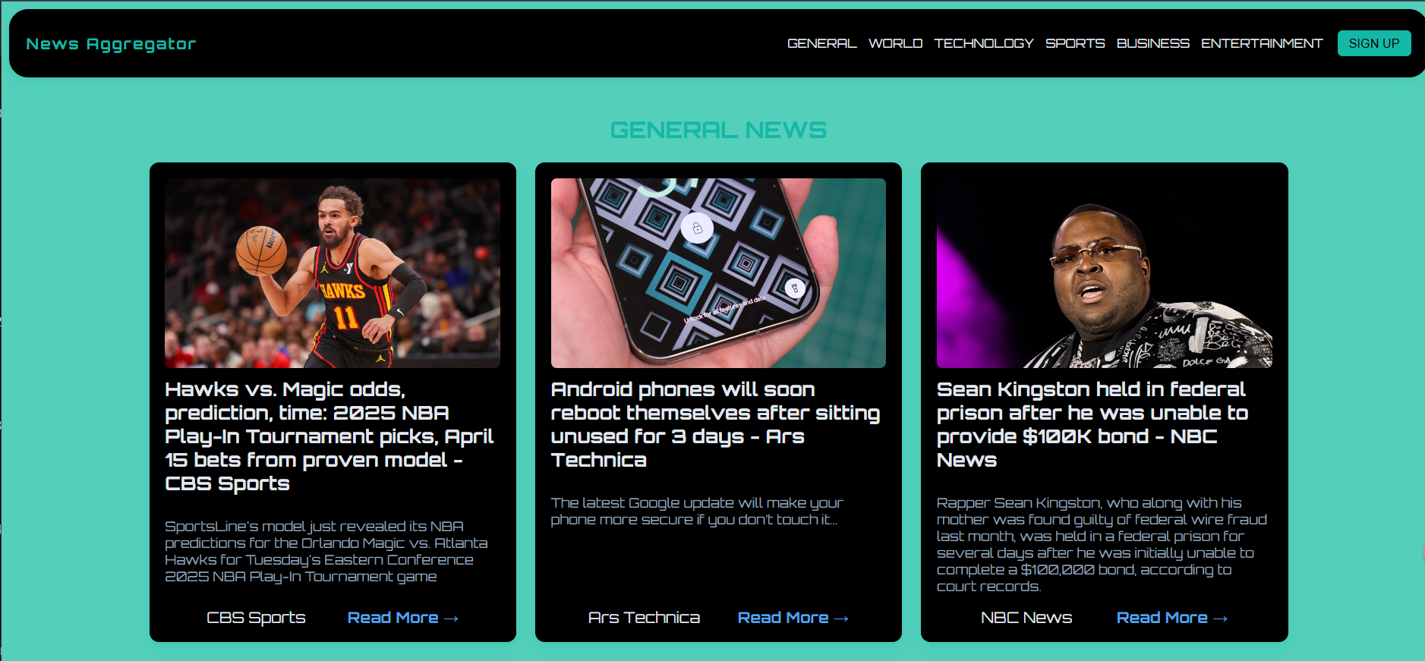
Home Page:
Home page where user can get the information about their interested fields.

Slide 9
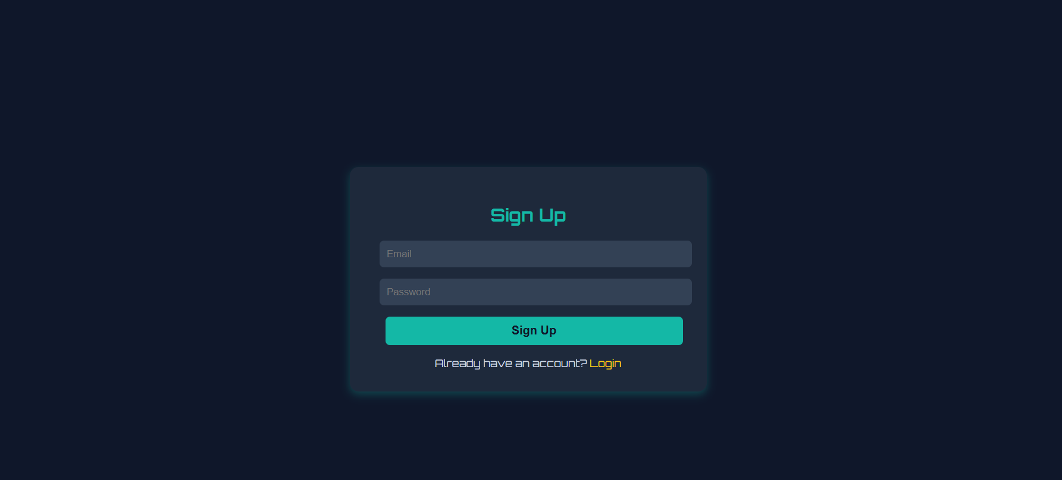
Signup/Login Page:
This page can be used by the user to Signup if don’t have any account but in case he/she has account so they can simply login into there account.

Slide 10
Features:
News Aggregator
Login/Signup Functionality
Feed According to the interested field.
User Account
User Dashboard

Slide 11
Thank You

